Slide 1


CAPSTONE PROJECT
Healthcare Infrastructure Analytics of AIIMS Hospitals in India Using Power BI
Presented By
Student Name: ALWIN SUDHEESH
College Name: INDIRA GANDHI NATIONAL OPEN UNIVERSIRTY, COchin
Department: Commerce , BCOMF
Email ID: alwinsudheesh@gmail.com

Slide 2
OUTLINE:
Problem Statement Proposed System/Solution
System Development Approach
Algorithm & Deployment
Result
Conclusion
Future Scope
References

Slide 3
Problem Statement:
Healthcare infrastructure plays a crucial role in delivering quality medical services. Government hospitals such as AIIMS must effectively manage and monitor critical resources such as ICU beds, oxygen beds, and operational hospital beds. However, analyzing raw infrastructure data across multiple hospitals can be difficult and time-consuming. Without proper visualization, it becomes challenging for administrators to identify hospital capacity, compare infrastructure levels, and make data-driven decisions.
Therefore, there is a need for an analytical dashboard that can visually present healthcare infrastructure data for better understanding and decision-making.

Slide 4
Proposed Solution:
The proposed solution is to develop a Power BI dashboard that analyzes healthcare infrastructure data of AIIMS hospitals across India.
The dashboard provides:
Summary metrics of ICU beds, oxygen beds, and operational beds
Hospital-wise infrastructure comparison
Distribution of critical care and oxygen bed capacity
Interactive filtering for individual hospitals
Visual insights to support healthcare infrastructure planning
This dashboard helps stakeholders easily analyze and interpret hospital infrastructure data.

Slide 5
System Approach:
The system was developed using Microsoft Power BI, a powerful data visualization and business intelligence tool.
Tools and Technologies Used
Microsoft Power BI Desktop
Power Query for data transformation and cleaning
DAX (Data Analysis Expressions) for creating calculated measures
Data Visualization techniques such as bar charts, donut charts, and KPI cards
System Requirements
Power BI Desktop
Operationalization of dedicated hospital beds, and beds with ventilators dataset
Windows operating system

Slide 6
Algorithm & Deployment:
The following steps were followed to develop the dashboard:
Import the Operationalization of dedicated hospital beds, and beds with ventilators into Power BI.
Perform data cleaning and transformation using Power Query.
Create calculated measures using DAX functions to compute totals and key metrics.
Design interactive visualizations including:
KPI cards
Bar charts
Donut charts
Data tables
Add slicers to enable interactive filtering by hospital.
Arrange the visuals to create an interactive analytical dashboard.

Slide 7
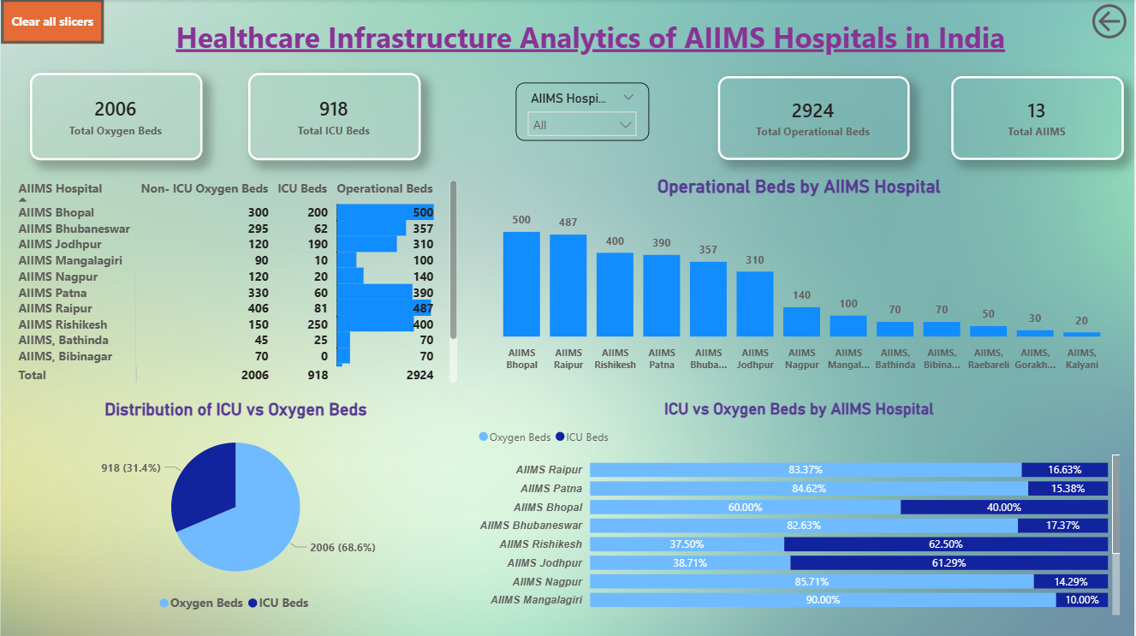
Result:
The developed dashboard successfully visualizes the healthcare infrastructure data of AIIMS hospitals in India.
The dashboard provides:
Total oxygen beds: 2006
Total ICU beds: 918
Total operational beds: 2924
Total AIIMS hospitals analyzed: 13
The dashboard enables users to compare hospital capacities, analyze bed distribution, and identify hospitals with higher healthcare infrastructure availability.

Slide 8
Conclusion:
The Power BI dashboard provides a clear and interactive visualization of healthcare infrastructure data across AIIMS hospitals. By transforming raw data into meaningful insights, the dashboard helps stakeholders understand hospital capacity, resource distribution, and infrastructure availability.
This analytical approach improves data interpretation and supports better planning and management of healthcare infrastructure.

Slide 9
Future scope:
The project can be further enhanced by:
Integrating real-time hospital infrastructure data
Expanding the dataset to include more hospitals and states
Adding time-series analysis to track infrastructure growth
Incorporating patient admission and bed occupancy data
Developing predictive models to forecast healthcare demand

Slide 10
References:
Microsoft Power BI Documentation
The National Data and Analytics Platform (NDAP) - https://ndap.niti.gov.in/
DATASET = Operationalization of dedicated hospital beds, and beds with ventilators - https://ndap.niti.gov.in/dataset/1358
AICTE Internship Program Resources
Power BI Report Link ( Github ) - https://github.com/alwinsudheesh/AIIMS-Healthcare-Infrastructure-PowerBI-Dashboard/blob/main/AIIMS_Healthcare_Infrastructure_Dashboard.pbix

Slide 11
Thank You

